Slide 1

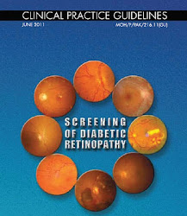
Performance Comparison of different molecular data in the identification of diabetic retinopathy
By
2019/E/011
2019/E023
This Photo by Unknown author is licensed under CC BY-SA-NC.

Slide 2
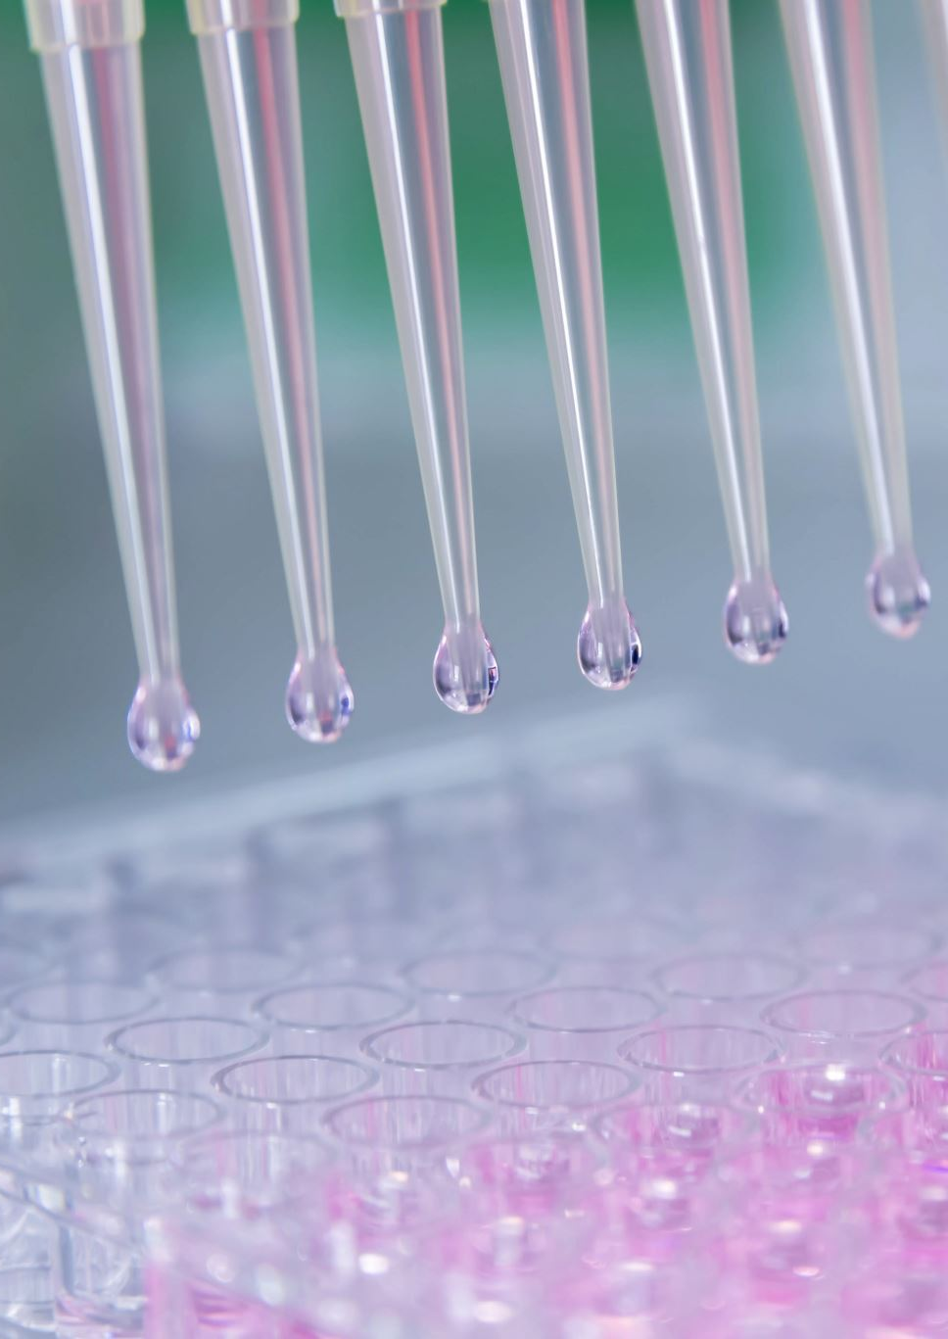
Introduction
Diabetic retinopathy is a severe eye disease that can lead to blindness. Early detection and treatment of diabetic retinopathy can help to prevent blindness.
Currently, the diagnosis of DR primarily relies on clinical evaluation and imaging techniques, such as fundus photography or optical coherence tomography.
In here, we are using various molecular data, including DNA, RNA, and protein, to develop a model that can accurately predict the presence of diabetic retinopathy.

Slide 3
Literature review
What they have done already in this area.
4 to 5 papers and what they have done
May be more than one slide can be used for this purpose

Slide 4
Gap in the literature
How you can relate your work with them.
Problem in their work
What is the gap between their work and your work.
From the same 4 to 5 papers
In the previous slide
May be more than one slide can be used for this purpose

Slide 5
Data to be used in this work
Alterations of 5-Hydroxymethylcytosines in Circulating Cell-free DNA Reflect Retinopathy in Type 2 Diabetes
This contains genome-wide methylation profiles of circulating cell-free DNA (cfDNA) from 70 Chinese patients with type 2 diabetes mellitus (T2DM), including 35 patients with diabetic retinopathy (DR) and 35 age-, gender-, and diabetic duration-matched controls.
2. In-depth transcriptomic analyses investigating molecular mechanisms underlying diabetic retinopathy
This is a collection of transcriptomic data from human post-mortem retinal samples. The data was collected from 80 patients diagnosed with various stages of diabetic retinopathy (DR). The data was analyzed using RNA-Seq, a high-throughput sequencing technique that can measure gene expression in a sample.
totalRNA
smallRNA

Slide 6
Plan of our work

Slide 7
End
Thank you
Feel free to change the headings. But keep the flow. Use your creativity by adding graphs or pictures or diagram

